Slide 1


Eclipse

Slide 2
About IDEs
An IDE is an Integrated Development Environment
Different IDEs meet different needs
  BlueJ, DrJava are designed as teaching tools
    Emphasis is on ease of use for beginners
    Little to learn, so students can concentrate on learning Java
  Eclipse, JBuilder, NetBeans are designed as professional-level work tools
    Emphasis is on supporting professional programmers
    More to learn, but well worth it in the long run
We will use Eclipse, but other professional IDEs are similar
The following slides are taken from
www.eclipse.org/eclipse/presentation/eclipse-slides.ppt

Slide 3
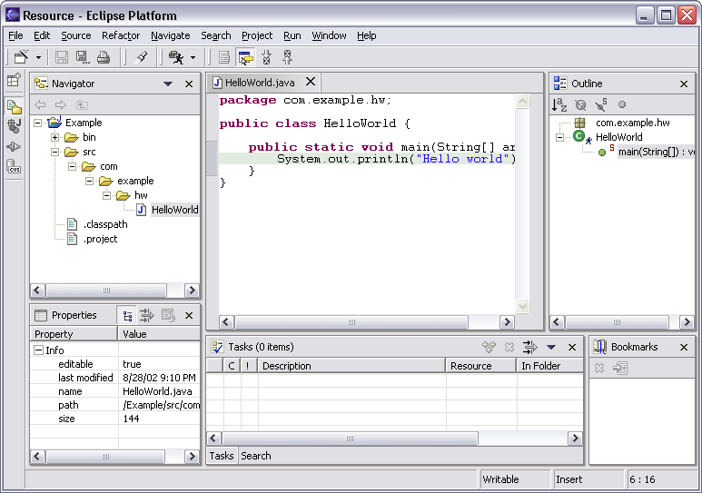
Workbench Terminology
Menu bar
Text
editor
Tool bar
Perspective
and
Fast View
bar
Outline
view
Resource
Navigator
view
Bookmarks
view
Properties
view
Message
area
Editor
Status
area
Tasks
view

Slide 4
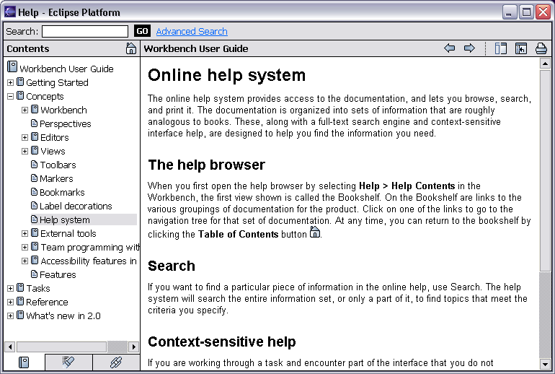
Help Component
Help is presented in a standard web browser

Slide 5
Java Development Tools
JDT = Java development tools
State of the art Java development environment
Built atop Eclipse Platform
  Implemented as Eclipse plug-ins
  Using Eclipse Platform APIs and extension points
Included in Eclipse Project releases
  Available as separately installable feature
  Part of Eclipse SDK drops

Slide 6
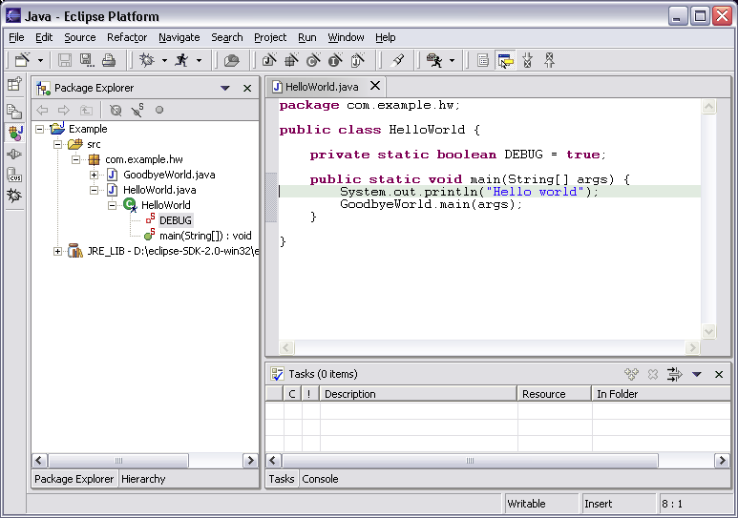
Java Perspective
Java-centric view of files in Java projects
  Java elements meaningful for Java programmers
Java
project
package
class
field
method
Java
editor

Slide 7
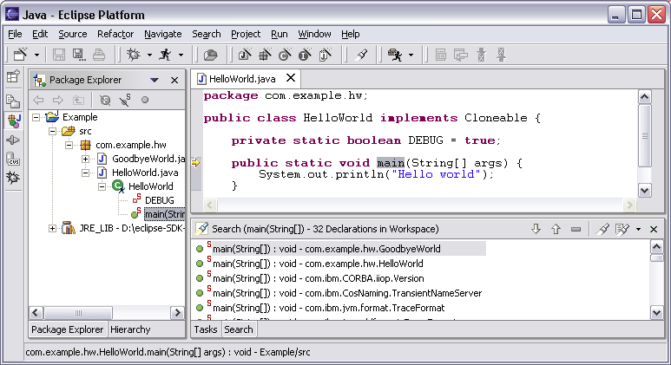
Java Perspective
Search for Java elements
  Declarations or references
  Including libraries and other projects
Hits
flagged
in margin
of editor
All search results

Slide 8
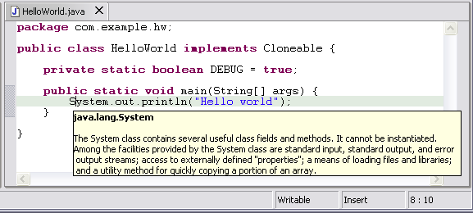
Java Editor
Hovering over identifier shows Javadoc spec

Slide 9
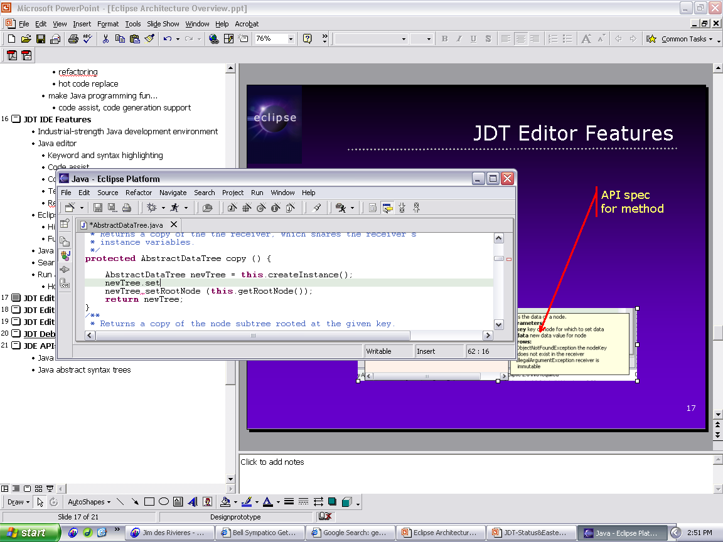
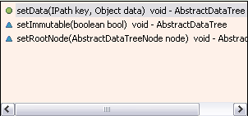
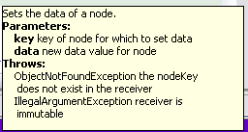
Java Editor
Method completion in Java editor
List of plausible methods
Doc for method

Slide 10
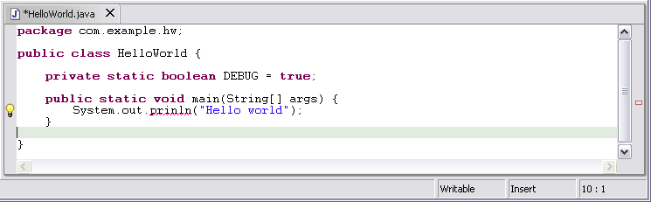
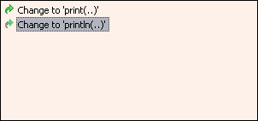
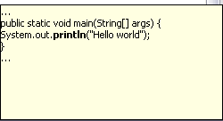
Java Editor
On-the-fly spell check catches errors early
Click
to see
fixes
Problem
Preview
Quick
fixes

Slide 11
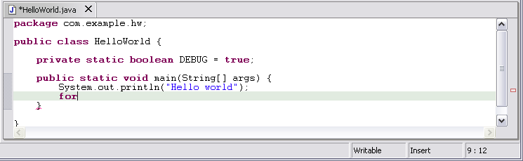
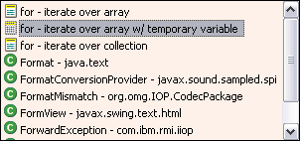
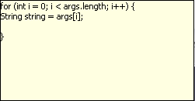
Java Editor
Code templates help with drudgery
Statement
template
Preview

Slide 12

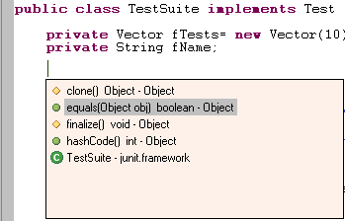
Java Editor
Java editor creates stub methods
Method stub insertion for anonymous inner types
Method stub insertion
for inherited methods

Slide 13
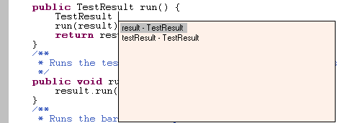
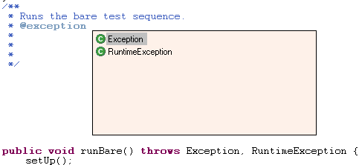

Java Editor
Java editor helps programmers write good Java code
Variable name
suggestion
JavaDoc
code assist
Argument hints and
proposed argument
names

Slide 14
Java Editor
Other features of Java editor include
  Local method history
  Code formatter

Slide 15
Eclipse Java Debugger
Run Java programs
  In separate target JVM (user selectable)
  Console provides stdout, stdin, stderr
  Scrapbook pages for executing Java code snippets
Debug Java programs
  Full source code debugging
  Any JPDA-compliant JVM
Debugger features include
  Method and exception breakpoints
  Conditional breakpoints
  Watchpoints
  Step over, into, return; run to line
  Inspect and modify fields and local variables

Slide 16
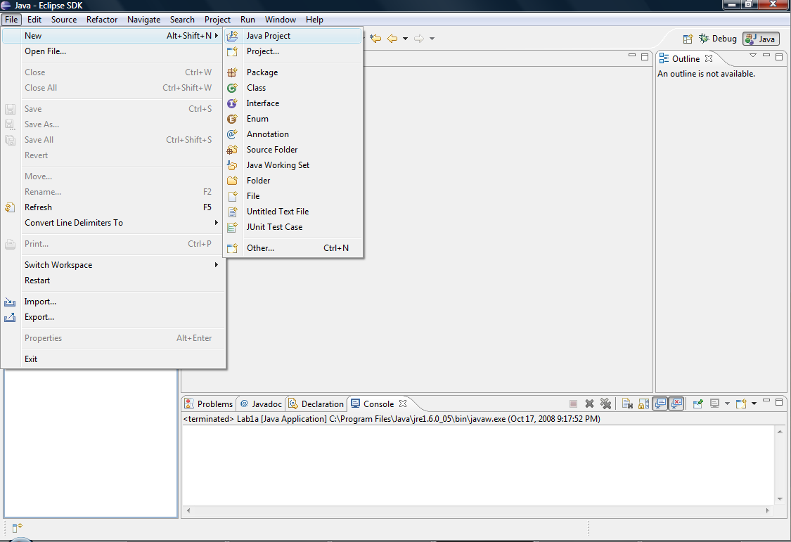

Slide 17
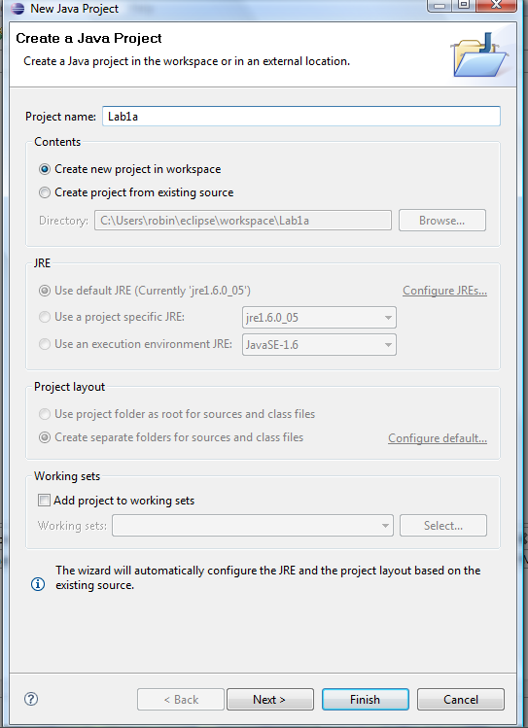

Slide 18
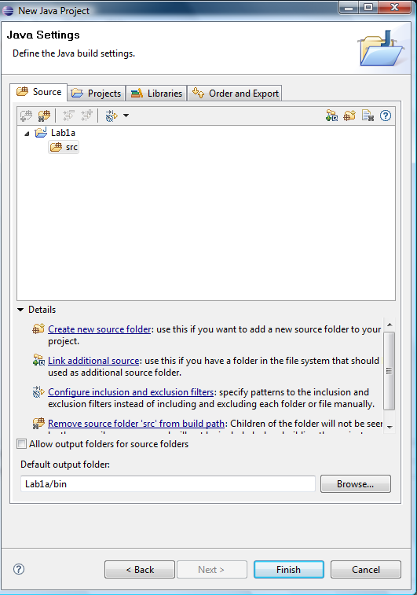

Slide 19
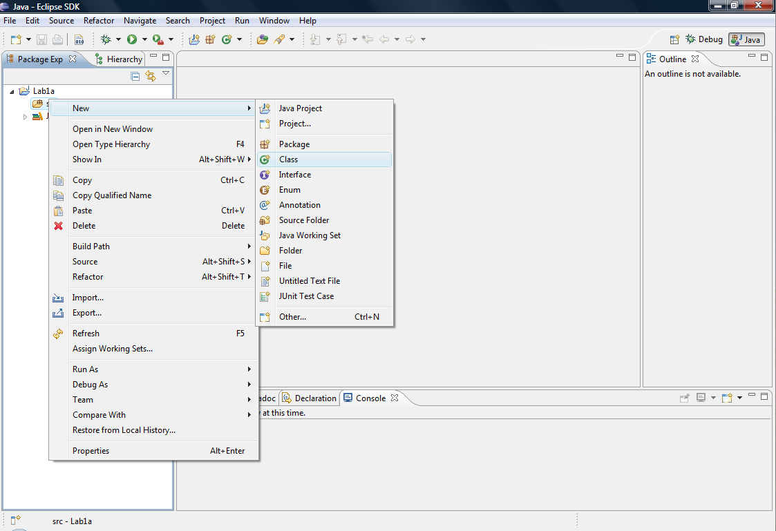

Slide 20
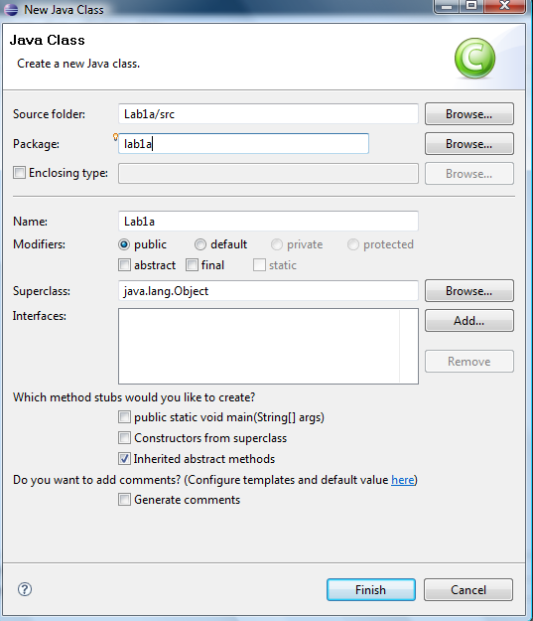

Slide 21
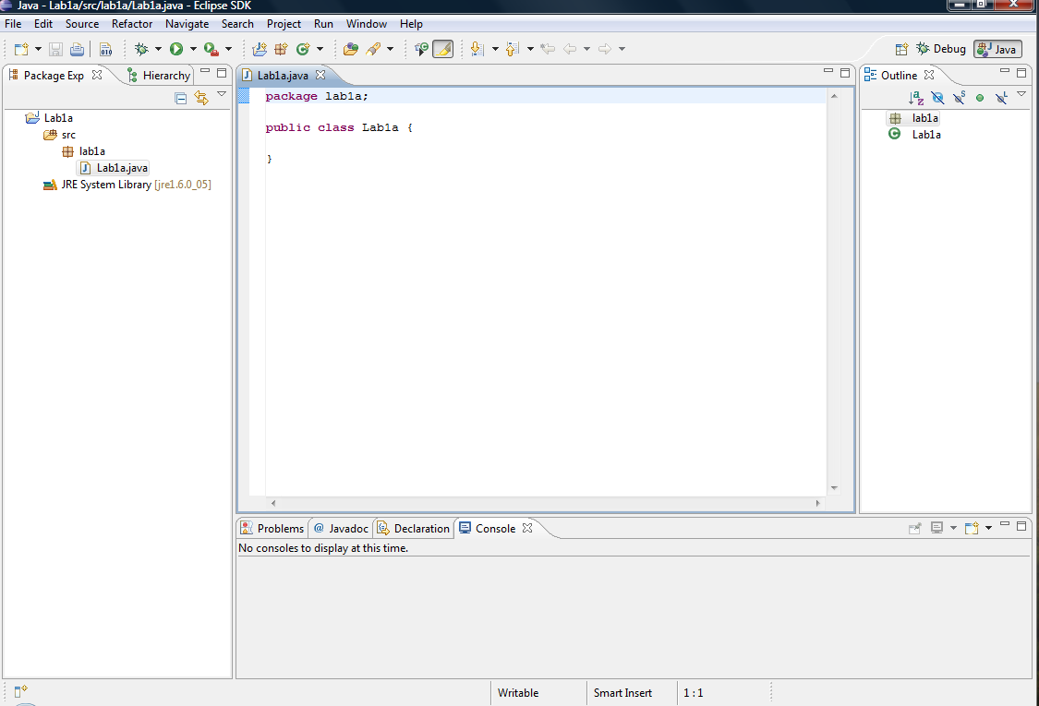

Slide 22
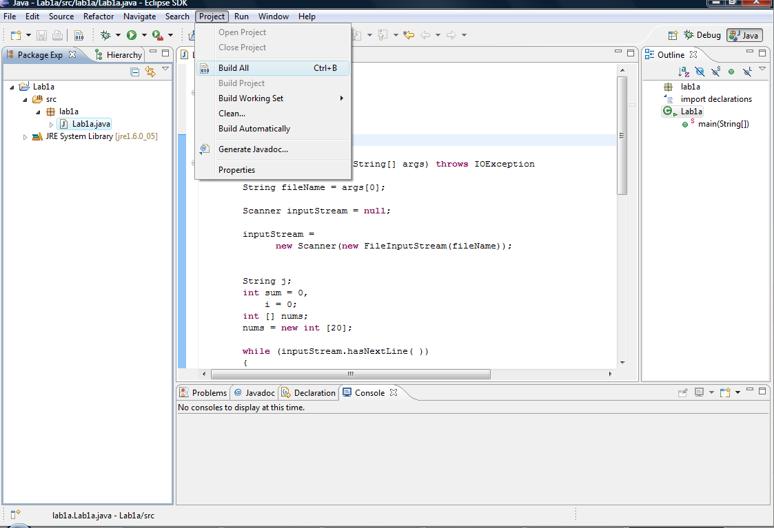

Slide 23
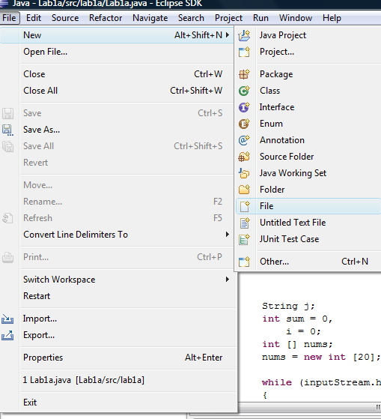

Slide 24
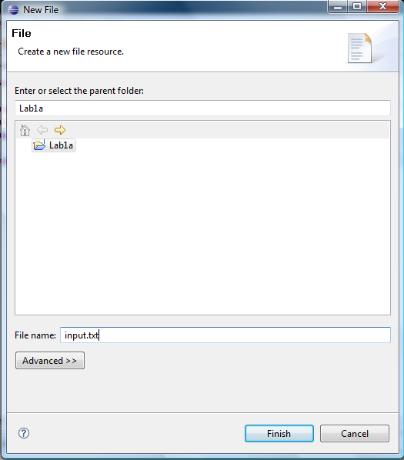

Slide 25
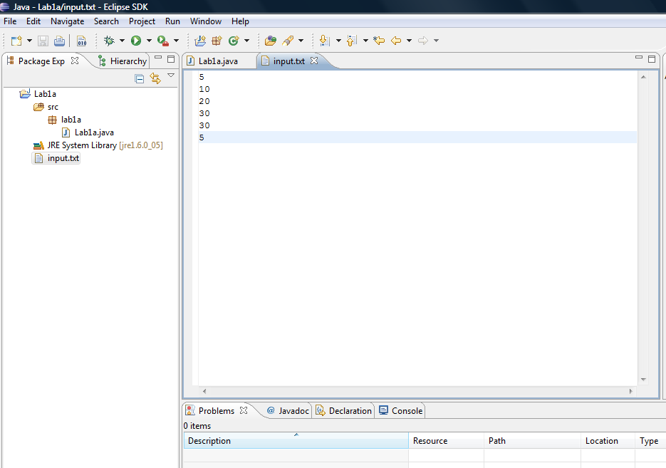

Slide 26
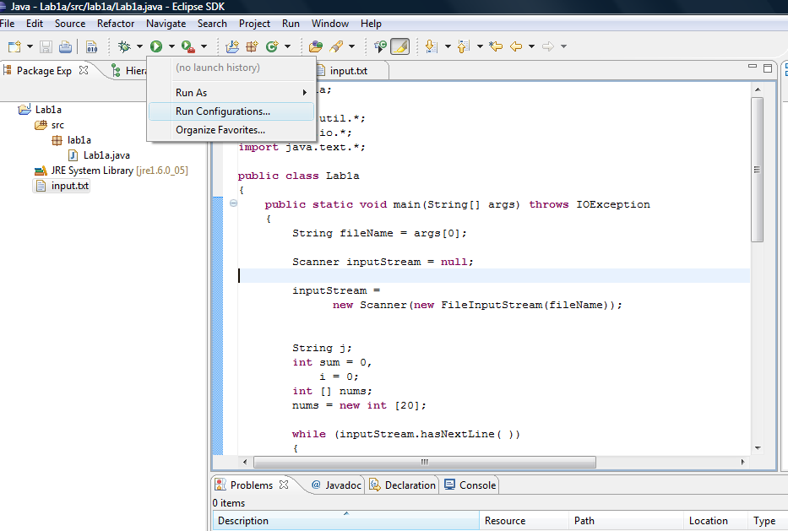

Slide 27
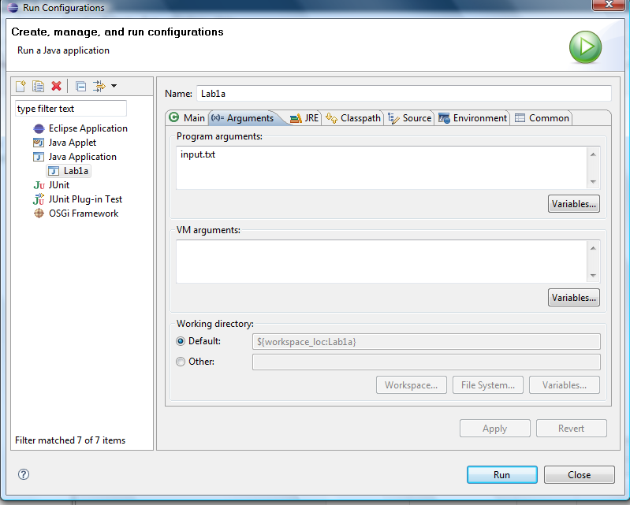

Slide 28
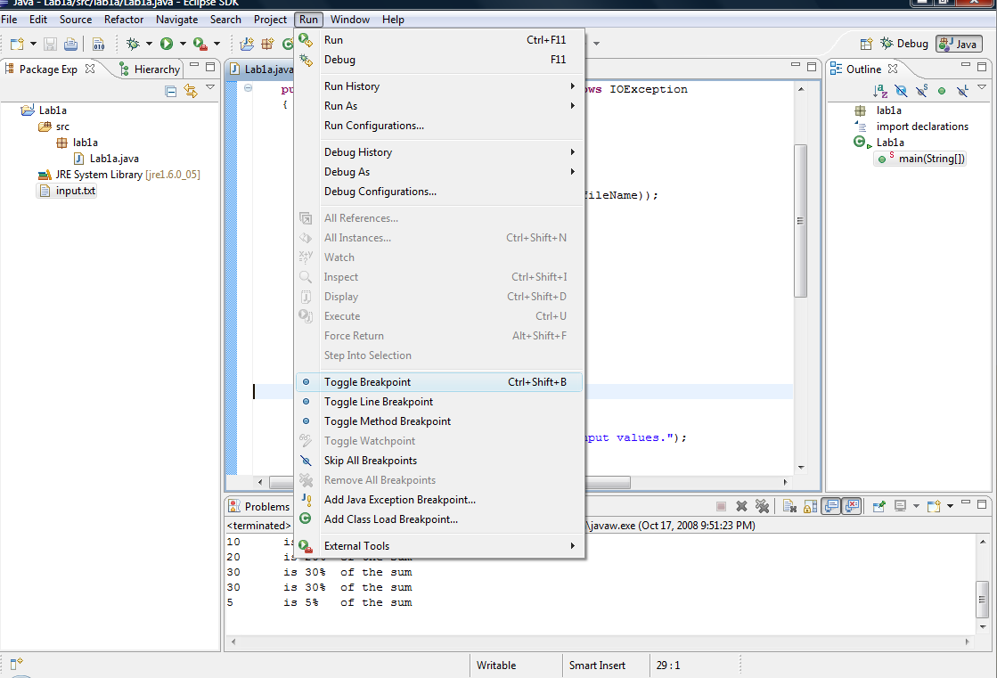

Slide 29
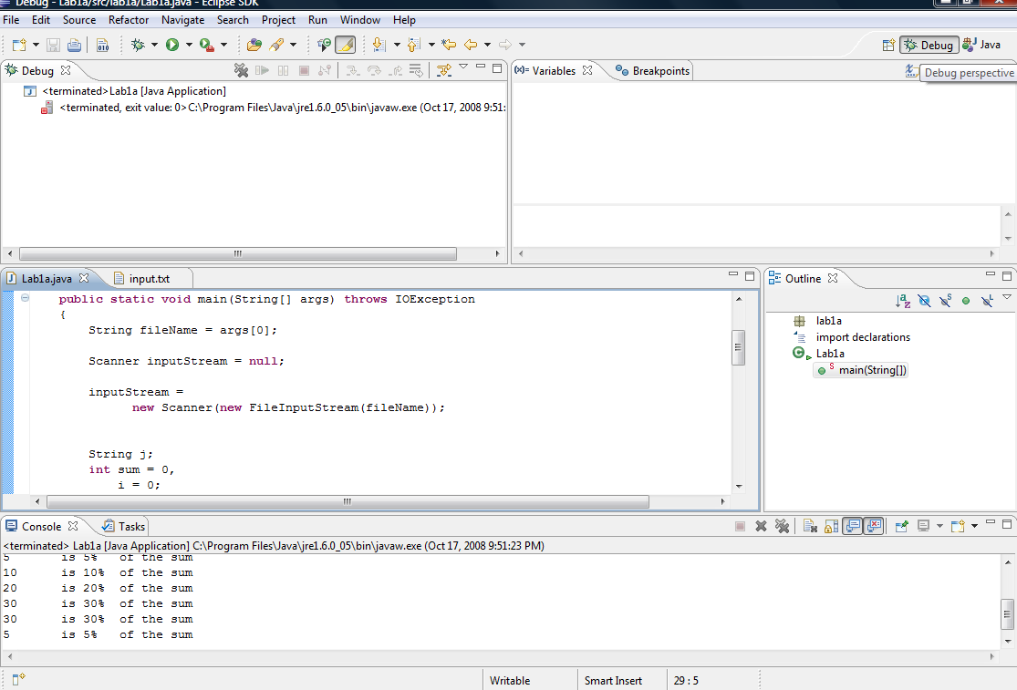

Slide 30
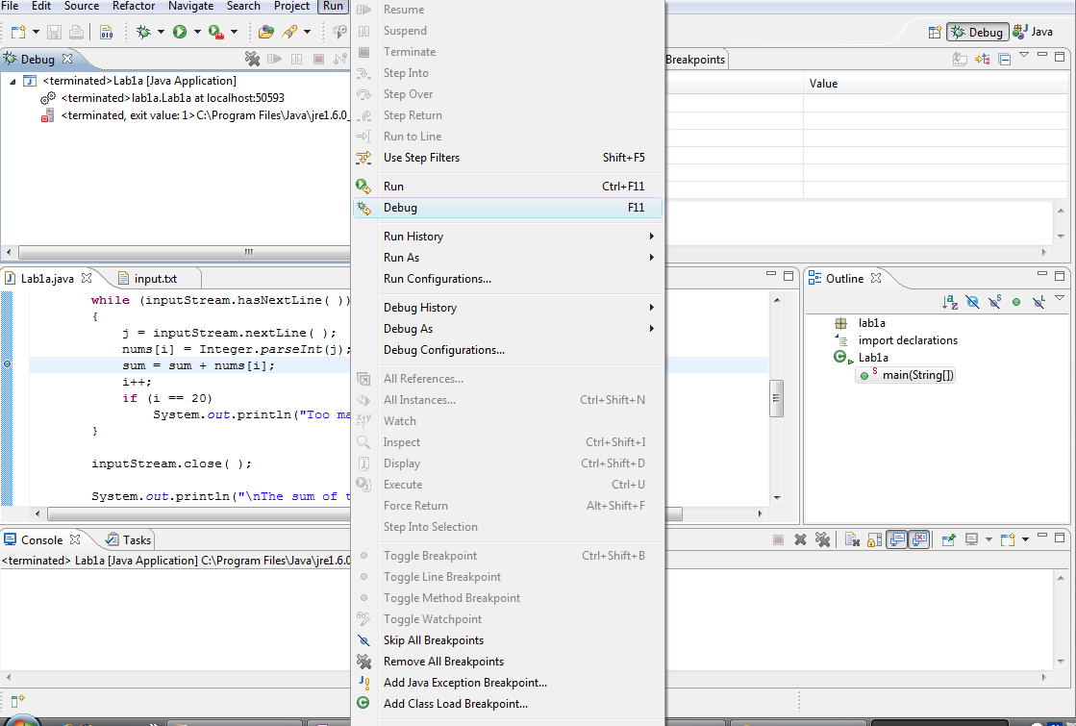

Slide 31
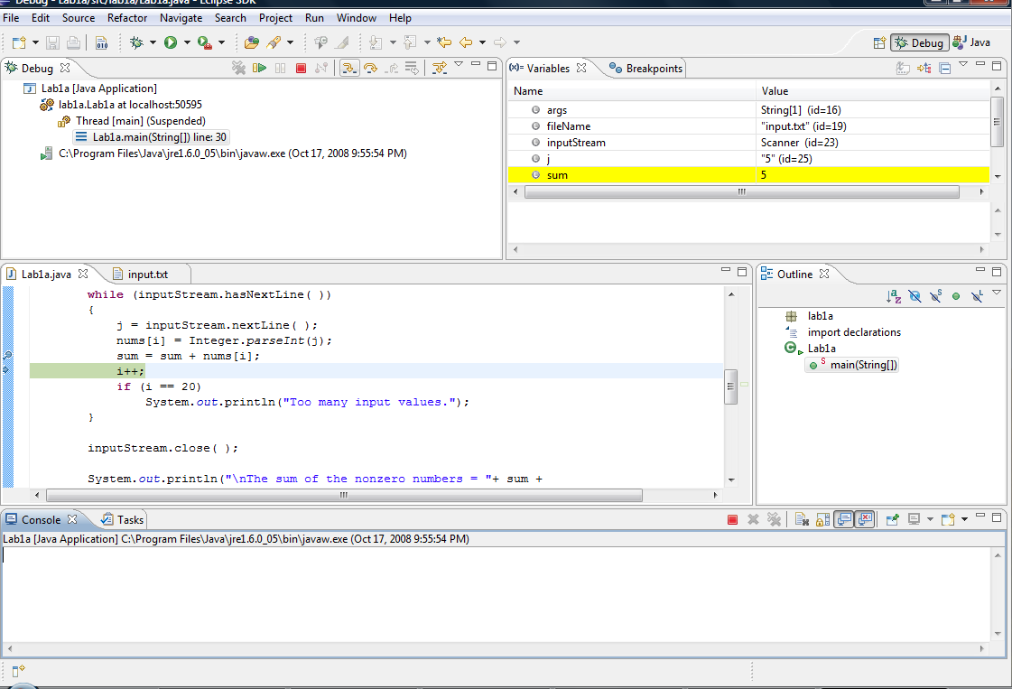

Slide 32
F5, F6 and F7
Lets discuss the purpose of F5, F6 and F7 keys in Debug mode.

Slide 33
Thank You

